Slide 1

Fractals
Keshav Malpani 2017MT10213
Vivek Muskan 2017MT10755
Supervisor: Dr. Amit Priyadarshi

Slide 2
Project Objective
To learn about the basics of Fractals, their formation and their properties
Approximating Fractals by plotting them upto n iterations
Learn about the fractional nature of Dimension
Find the dimensions of various fractals

Slide 3
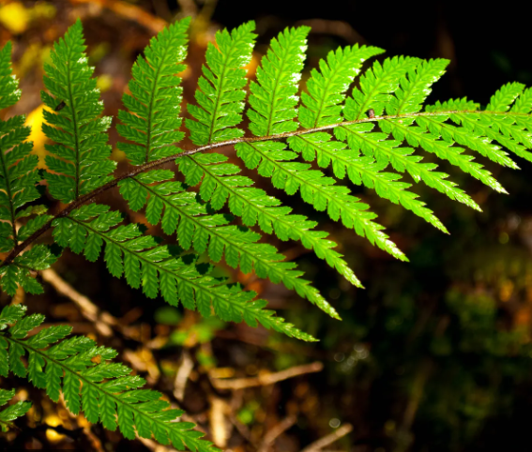
Introduction
Fractal - A pattern that the laws of nature repeats at different scales
In the past, mathematics has been concerned largely with sets and functions to which the methods of classical calculus can be applied
In recent years, it has been realised that these irregular sets represent some of the natural phenomenon in a much better way than the classical case
Triangular Fern

Slide 4
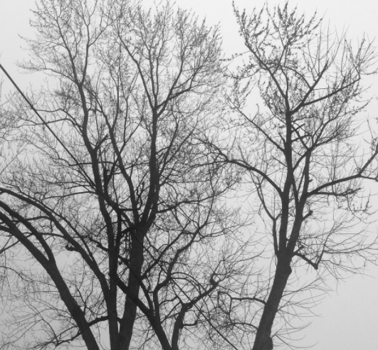
Motivating Examples
There are a lot of natural fractals which motivates for pursuing in this topic of study
Triangular Fern
Trees
Roses
River Deltas
Trees- the most natural example of Fractals

Slide 5
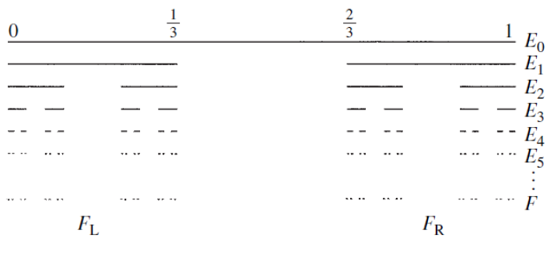
Middle Third Cantor Set
One of the best known examples of Fractals
Nth iteration set (E_{n}) is obtained by deleting middle one third of the intervals of the (n-1)th iteration set (E_{n-1})
The final set is the intersection of all the iterative sets E_{i}
If we begin the iterations using the unit interval [0,1] and apply above procedure, the sum of removed lengths equals unity
Dimension less than 1!

Slide 6
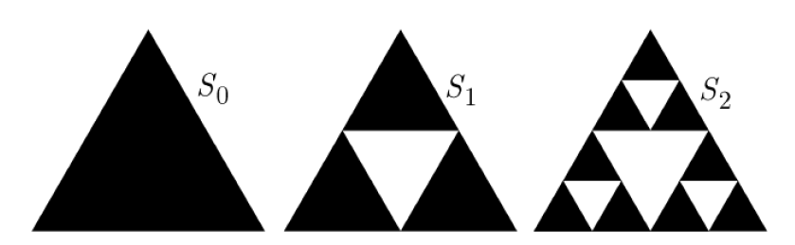
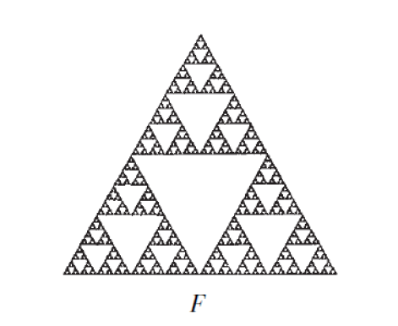
Sierpinski’s Triangle
Initial set is an Equilateral Triangle
Repeatedly we remove a smaller equilateral triangle from the middle with side length half of the original one
At nth iteration, the number of equilateral triangles equal 3^{n-1}
Sum of areas of all the removed triangles equal the area of original triangle
Sum of length of the edges of the triangle shoot to infinity
The dimension is somewhat in between 1 and 2!

Slide 7
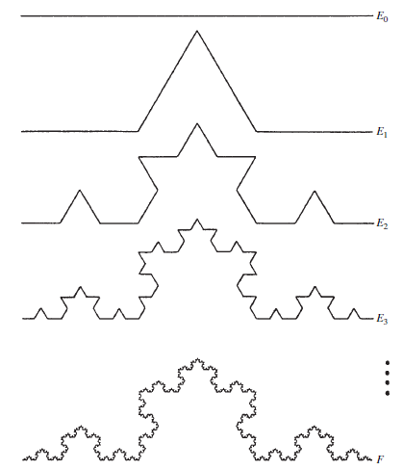
Koch’s Curve
Initial set is an Line Segment
Repeatedly we remove the middle third of each line segment and replace it with two sides of equi. triangle based on removed segment.
The size of line segment gets reduced to 1/3rd in each iteration
The number of structures get 4 times in each iteration
Koch Curve is the limiting curve of these

Slide 8

Iterated Function System : Definitions
Let D be a closed subset of ℝ^{n}, often D is ℝ^{n} itself. A mapping S ∶ D → D is called a contraction on D if there exists a number r with 0 < r < 1 such that |S(x) − S(y)| ⩽ r|x − y| for all x, y ∈ D
A finite family of contractions { S₁, S₂,. . . , S_{m} }, with m ⩾ 2, is called an iterated function system
A non-empty compact subset F of D is an attractor (or invariant set) for the IFS if it is made up of its images under the S, i.e. F= ∪ S_{i}(F)
If {S₁,....,S_{m}} is an IFS then there exists a unique non-empty attractor F of the IFS.
An iterated function system realizing a ratio list(r₁,r₂, . . . ,r_{n}) in a metric space is a list (S₁, S₂, . . . ,S_{n}), where S_{i}: ℝ^{n} → ℝ^{n} is a similarity with ratio r_{i} , i.e |S_{i}(x) − S_{i}(y)| = r_{i} |x − y| (x, y ∈ ℝ^{n} )
The attractor of a collection of similarities is called a self-similar set
The self-similarity dimension “s” satisfy :

Slide 9

Plotting Fractals : Chaos Game
Take a point inside the boundaries to be plotted
Randomly operate any one of the Contraction maps on the point to find the next point
The wanderer is attracted to the Attractor of the IFS and within a few thousand iterations, it starts following the attractor we try to plot

Slide 10
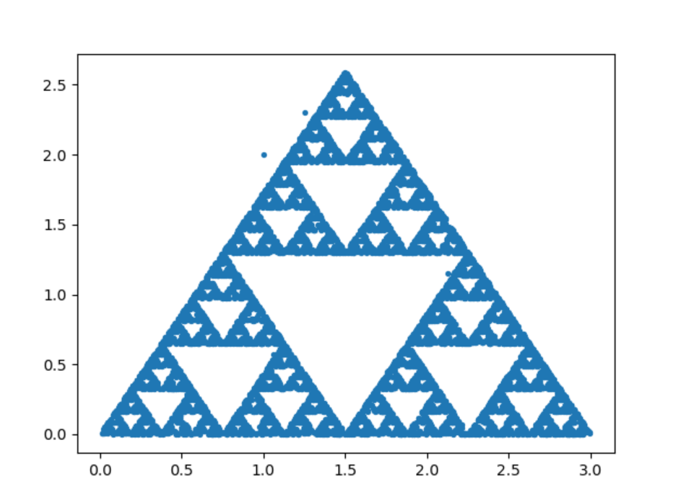
Plotting Sierpinski’s Triangle
IFS = {S₁, S₂, S₃} ; A,B,C initial points
S₁(x) = (x+A)/2
S₂(x) = (x+B)/2
S₃(x) = (x+C)/2
Ratio list = [½,½,½]
Similarity Dimension:
3*(½)^{s} = 1
s = (log 3)/(log 2)

Slide 11
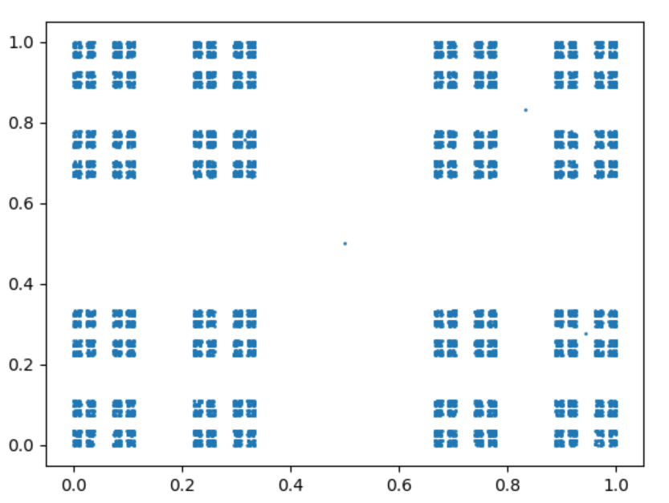
Plotting Cantor Dust
IFS = {S₁, S₂, S₃, S₄}
S₁((x,y)) = (x/3, y/3)
S₂((x,y)) = (x/3 + 2/3, y/3)
S₃((x,y)) = (x/3, y/3 + 2/3)
S₄((x,y)) = (x/3 + 2/3, y/3 + 2/3)
Ratio list = [⅓, ⅓, ⅓, ⅓]
Similarity Dimension:
4*(⅓)^{s} = 1
s = (log 4)/(log 3)

Slide 12
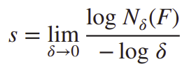
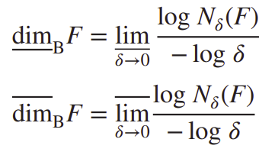
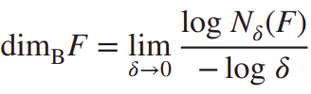
Box Counting Dimension - Definition
Given a subset F of the plane, for each 𝛿 > 0, we find the smallest number of sets of diameter at most 𝛿 that can cover the set F and we call this number N_{ẟ}(F). The dimension of F reflects the way in which N_{ẟ}(F) grows as 𝛿 → 0. If N_{ẟ}(F) obeys, at least approximately, a power law N_{ẟ}(F) ≃ c𝛿 ^{- s} for positive constants c and s, we say that F has box dimension s.
Taking logarithm to solve yield log N_{ẟ}(F) ≃ log c − s log 𝛿
Lower Box-counting dim :
Upper Box-counting dim :
If these are equal, we say common value is the Box-counting dimension of F, i.e.

Slide 13
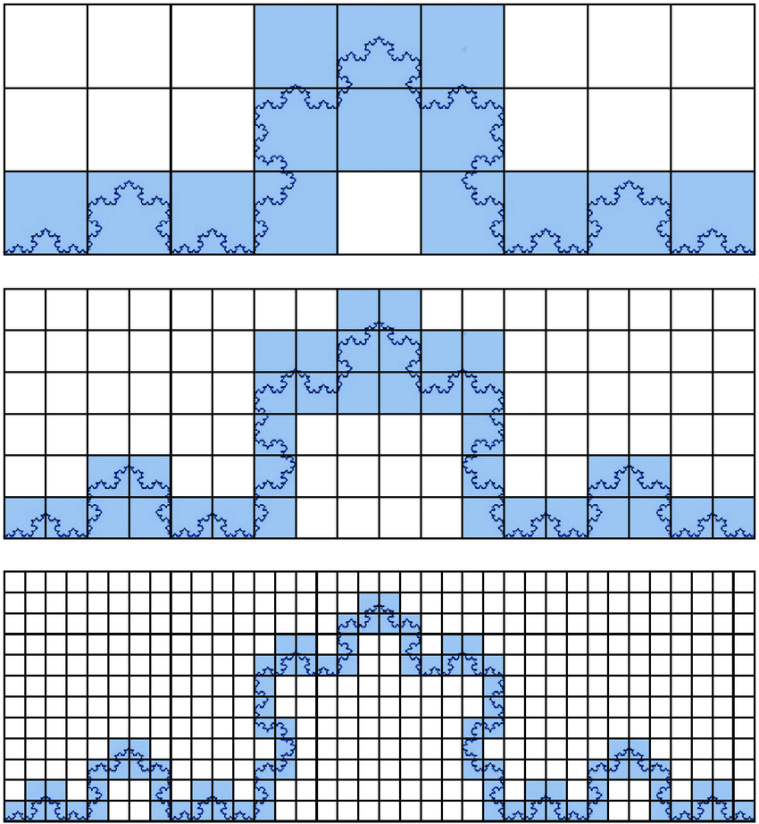
Box Counting Dimension - Interpretation
N_{ẟ}(F) can be interpreted as:
1. the smallest number of sets of diameter at most 𝛿 that cover F;
2. the smallest number of closed balls of radius 𝛿 that cover F;
3. the smallest number of cubes of side 𝛿 that cover F;
4. the number of 𝛿-mesh cubes that intersect F

Slide 14
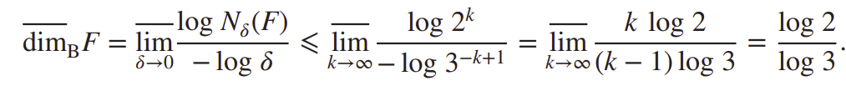
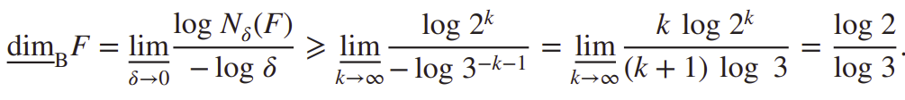
Box Counting Dimension (Theoretical) - Cantor Set
If 3^{- k} < 𝛿 ⩽ 3^{- k+1}, then the 2^{-k} level-k intervals of Ek of length 3^{−k} provide a 𝛿-cover of F, so that N_{ẟ}(F) ⩽ 2^{k}, where N_{ẟ}(F) is the least number of sets in a 𝛿-cover of F.
On the other hand, any interval of length 𝛿 with 3^{- k-1} ⩽ 𝛿 < 3^{- k} intersects at most one of the level-k intervals of length 3^{- k} used in the construction of F (the gap between the level-k intervals is at least 3^{- k}). There are 2^{k} such intervals, all containing points of F, so at least 2^{k} intervals of length 𝛿 are required to cover F. Hence, N_{ẟ}(F) ⩾ 2^{k} so

Slide 15
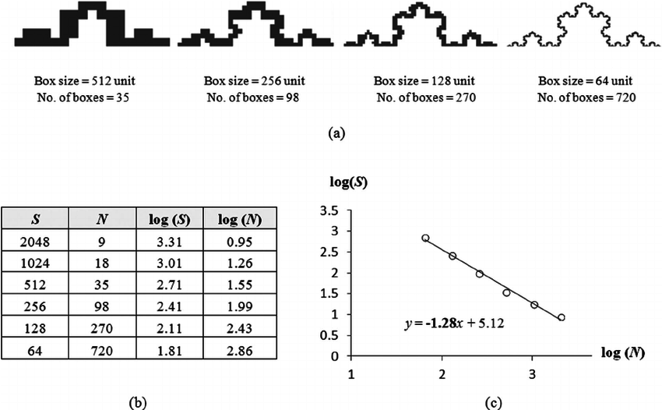
Box Counting Dimension (Practical) - Koch Curve

Slide 16
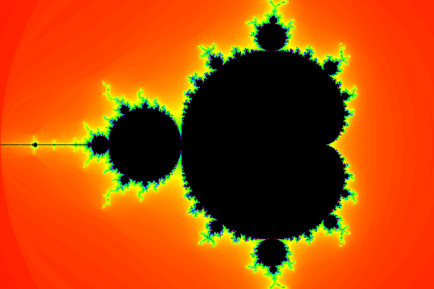
Conclusion and Further Work
We have learnt about the basics of Fractals, their nature and some of their properties.
We have been successful in finding the dimensions of various fractals along with plotting them to have a visualization of things going on in an approximation.
Our further targets are to delve a little deeper into Mandelbrot Set and then go towards compression of Fractal images

Slide 17
References
Chaos Game : https://en.wikipedia.org/wiki/Chaos_game
Iterated Function System https://www.algorithm-archive.org/contents/IFS/IFS.html
Fractal Geometry by Kenneth Falconer, Third Edition, Wiley Publications
Measure, Topology and Fractal Geometry by Gerald Edgar, Second Edition, Springer Publications

Slide 18
Questions?

Slide 19
Thanks!!

